Slide 1
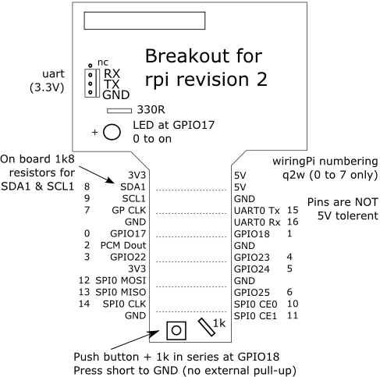
Breakout Board Details

Slide 2
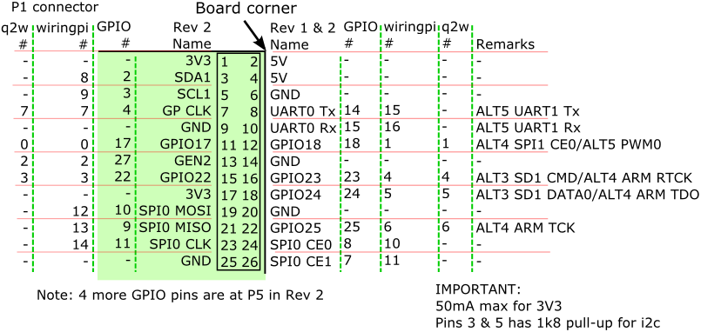
GPIO Pins
GPIO, wiringpi and quick2wire pin numbering
Pins are not 5V tolerant! 3.3V only !
Use wiringpi and q2w pins 0 to 7
For rpi revision 1 header pins:
3 – SDA0 / GPIO0
5 – SCL0 / GPIO1
13 – PCM Dout / GPIO21
UART0 Tx and Rx are used for use for terminal console.
DO NOT add pull-up for your i2c devices !

Slide 3
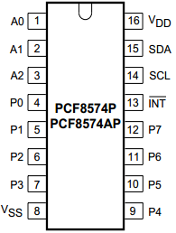
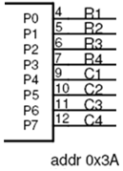
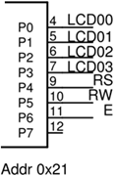
Interfaces
All are interfaced through PCF8574 or PCF8574A IO expander except accelerometer
keypad
- IO expander pins are open-drain type
- Can sink but cannot source
- For input, write 1 to the pin to cut-off transistor
IO expander pins
LEDs & Switches
P0
P1
P2
P3
P4
P5
P6
P7
4 DIP
switches
leds
5V
SDA
SCL
GND
4 LEDs
5V
SDA
SCL
GND
DIP switches
i2c addr: 0x3b
Accelerometer ADXL345
Use 3V3 ONLY
i2c addr: 0x3a
1 VDD 3V3
2 GND GND
3 CS 3V3
4 VS 3V3
5 INT1
6 INT2
7 SDO 3V3 - addr 0x1d
GND - addr 0x53 (use this)
8 SDA SDA
9 SCL SCL
1
9
LCD
5V
SDA
SCL
GND
LCD
i2c addr: 0x21

Slide 4
Proposed Breadboard Layout
IMPORTANT:
ADXL345 uses 3V3.
The rest use 5V.
Create a bus of i2c signals:
5V
SDA
SCL
GND
LCD
3V3 ONLY !

